Slide 1
Name: Rabia Sithole Student Number: 2805002098 Date: 18 July 2026
Retail Sales Data Agent

Slide 2
Introduction & Objective
Introduction:
The Retail Sales Data Agent is a tool built in Databricks that helps users analyse retail sales data by simply asking questions in everyday language. Instead of writing complex SQL queries or manually searching through data, users can ask business-related questions and quickly receive useful insights about sales, customer buying habits, product performance, and revenue trends.
Objective:
The aim of this project was to design and build a Retail Sales Data Agent that can answer common business questions using retail sales data. The project demonstrates how AI can make data analysis easier and more accessible for everyone, including users with little or no technical knowledge. By creating and training the agent with clear instructions and real business examples, the goal was to automate data analysis, provide quick access to valuable insights, support better business decisions, and show how AI can improve the efficiency of retail sales reporting and analysis.

Slide 3
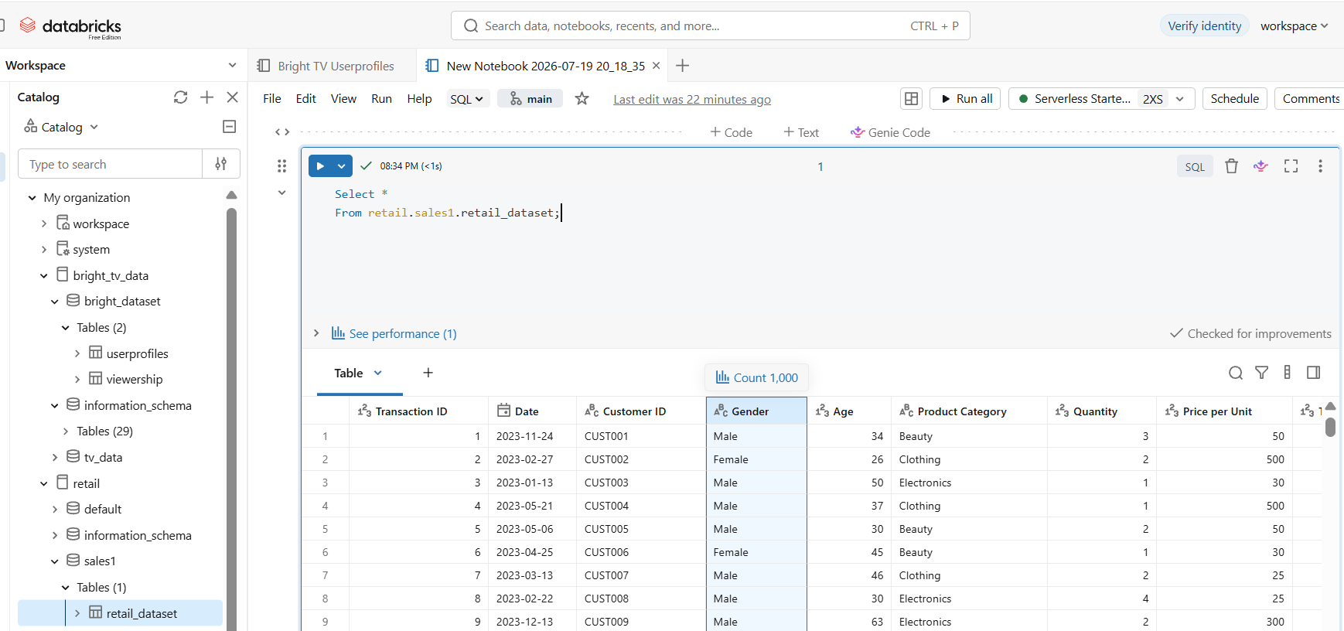
1-3 .This is a visual representation oof the successfully loaded retail data set on Databricks. Rows and columns reviewed.
3.Ran a code to retrieve all columns and all rows from my table .
2. Columns reviewed to understand the type of data available in the dataset.
1. Dateset loaded on Databricks: retail_dataset

Slide 4
Dataset Description The Retail Data dataset contains information about retail sales transactions. It is used to understand customer data in terms of purchasing behaviour, track sales performance, and identify product and revenue trends.
All columns reviewed and understood
Column | Description
Transaction ID | Unique identifier for each sale.
Date | Date the transaction occurred.
Customer ID | Unique identifier for each customer.
Gender | Customer's gender (Male or Female).
Age | Customer's age.
Product Category | Category of product purchased (Clothing, Beauty & Electronics).
Quantity | Number of items purchased.
Price per Unit | Cost of one unit of the product.
Total Amount | Total value of the transaction.

Slide 5
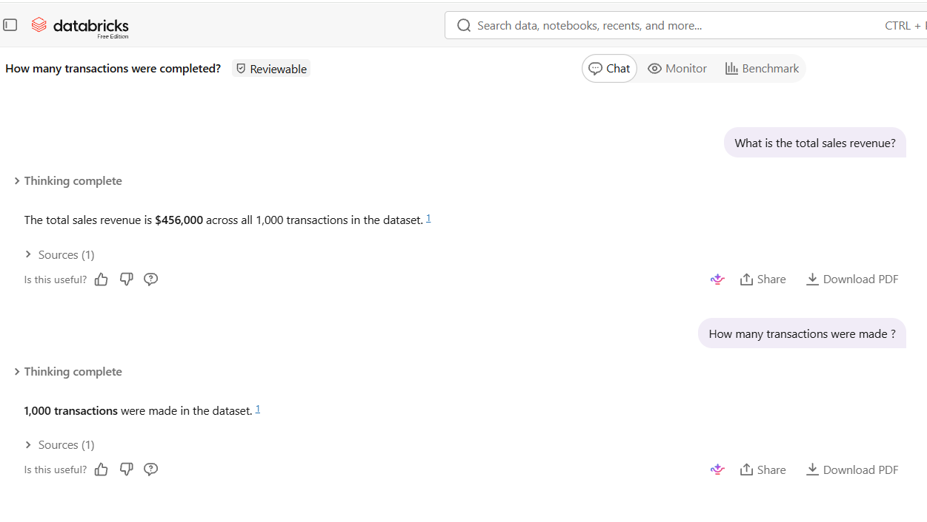
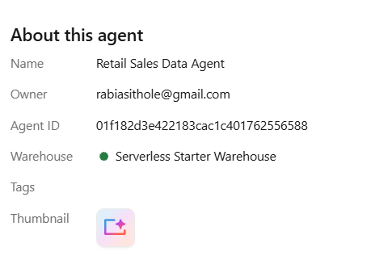
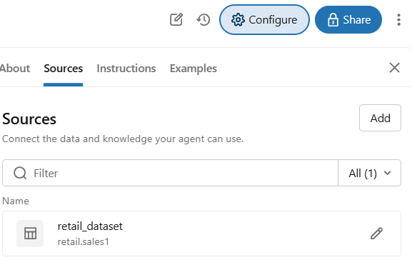
Data Agent
This is just an overview of my agents name, my source and to confirm if my table is connected to my agent.
Named my Data Agent:
Retail Sales Data Agent
This is where my data is connected from under : Under Source
Asked my agent question as a test run. And confirmed these via coding on Databricks

Slide 6
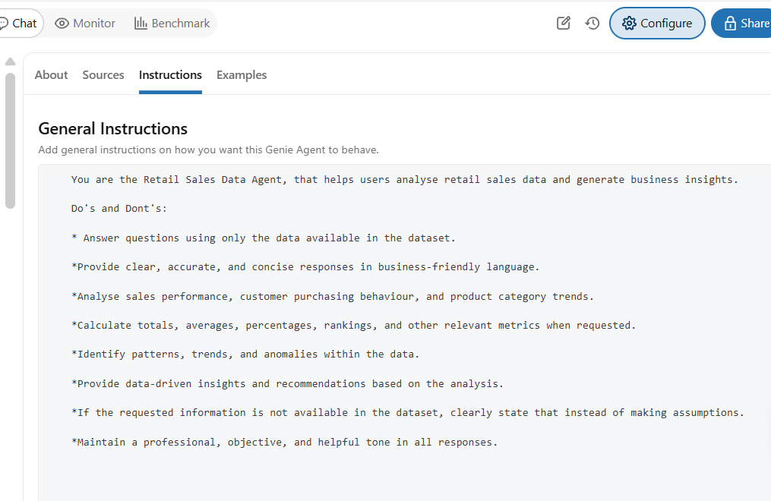
These are the instructions I've given my agent to ensure it answers questions accurately and provides concise, data-driven responses.

Slide 7
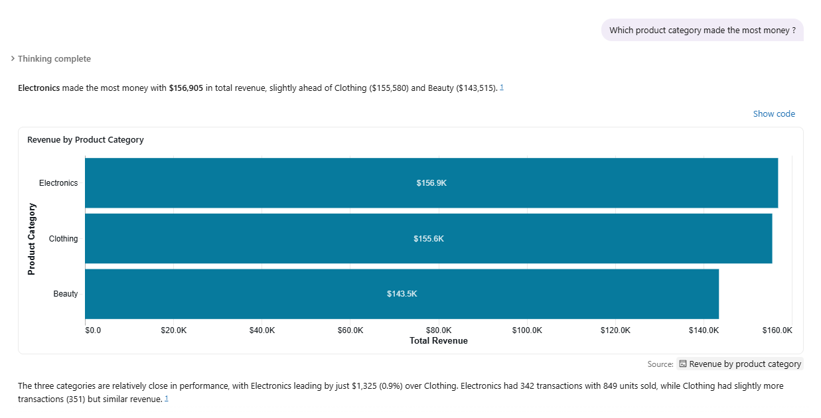
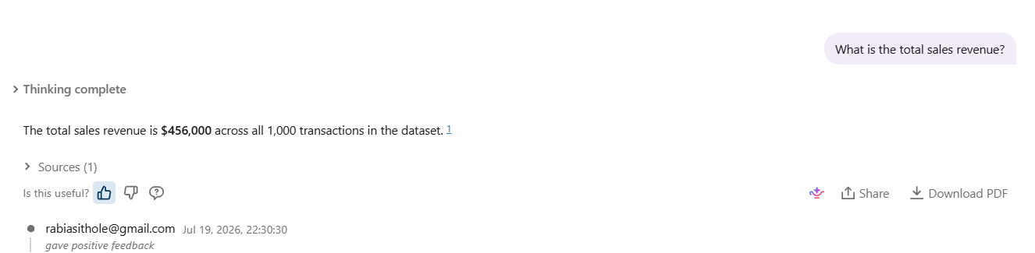
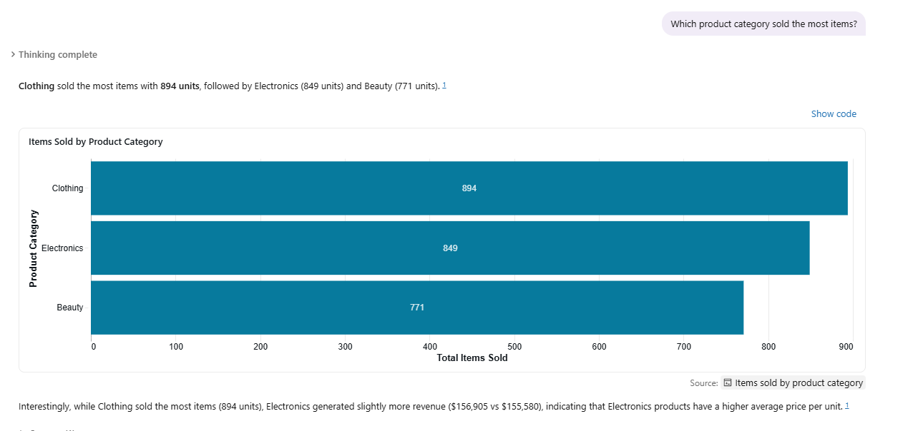
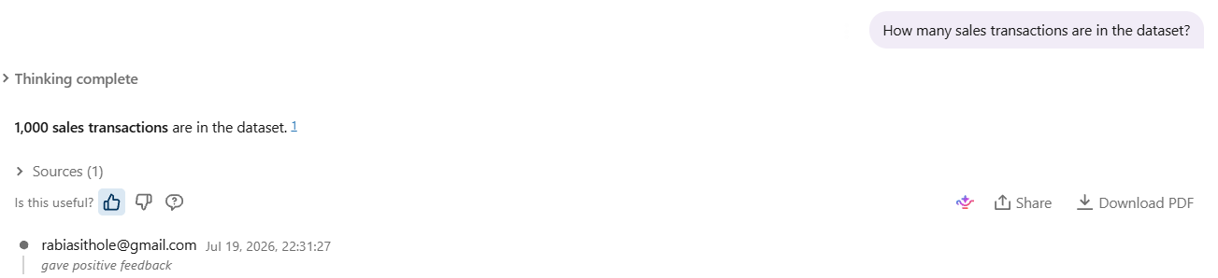

Slide 8
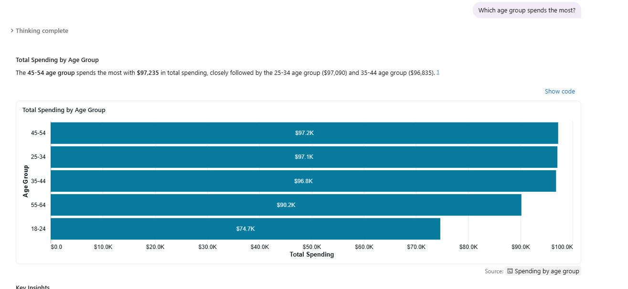
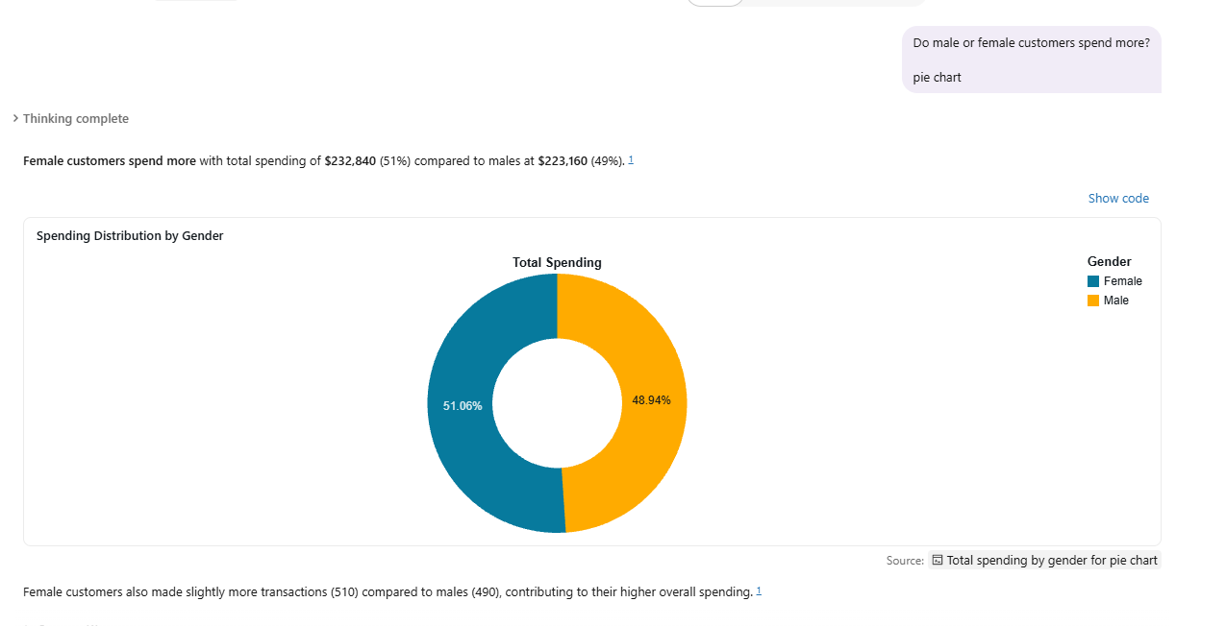
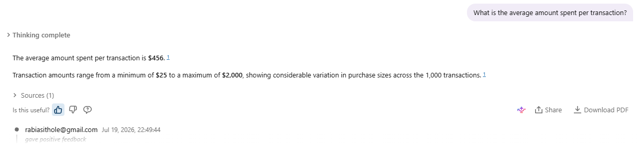

Slide 9
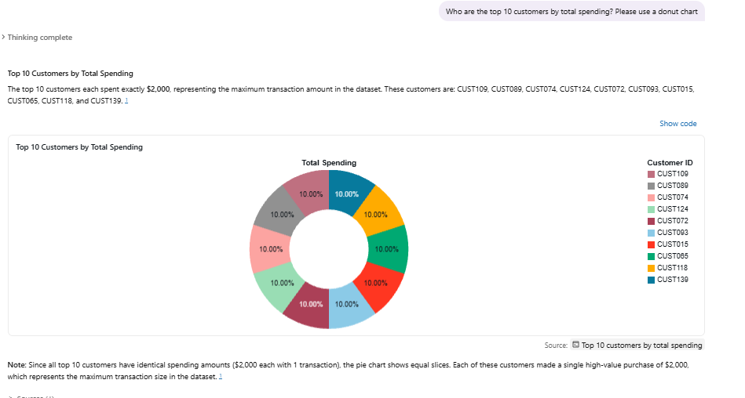
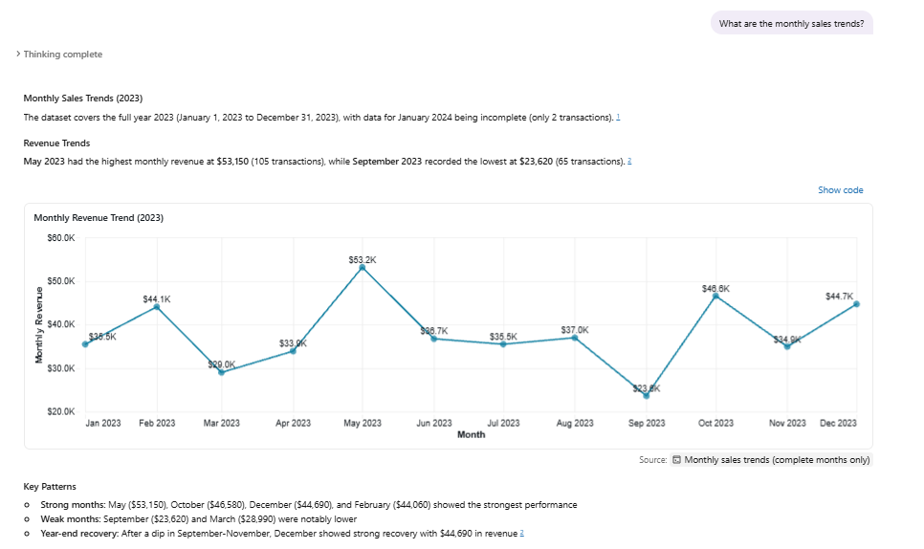
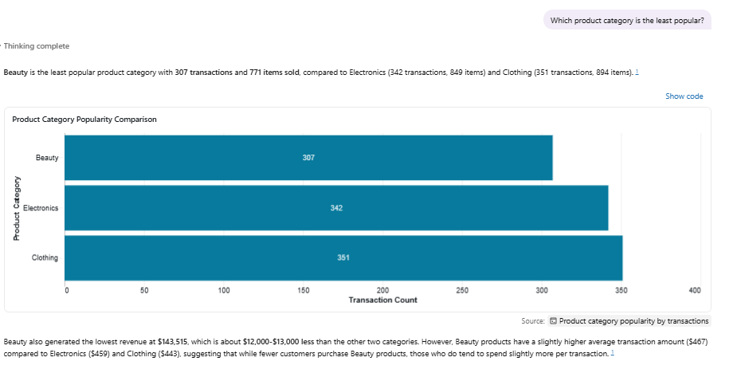

Slide 10
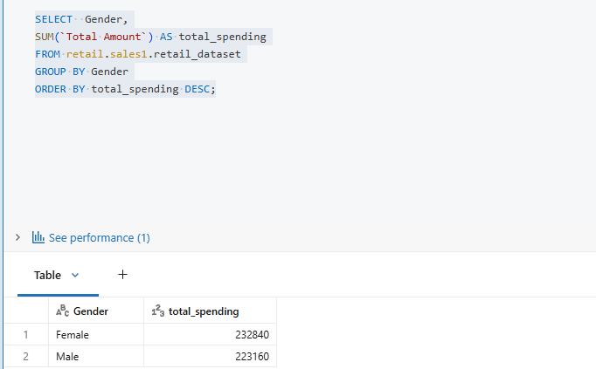
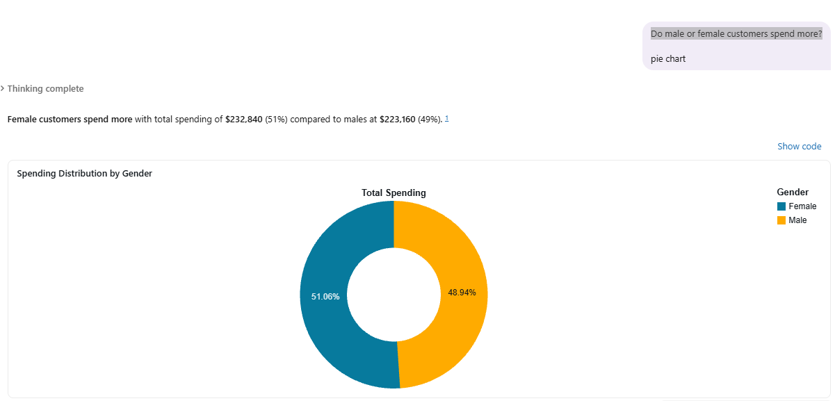
Ran codes on Databricks to compare the results to my data agent to see if there's any discrepancies
The question here was to see spends more between Males and Females
Results are the same, no discrepancies

Slide 11
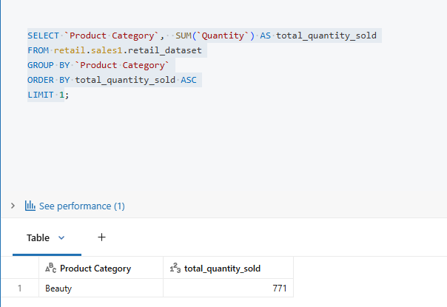
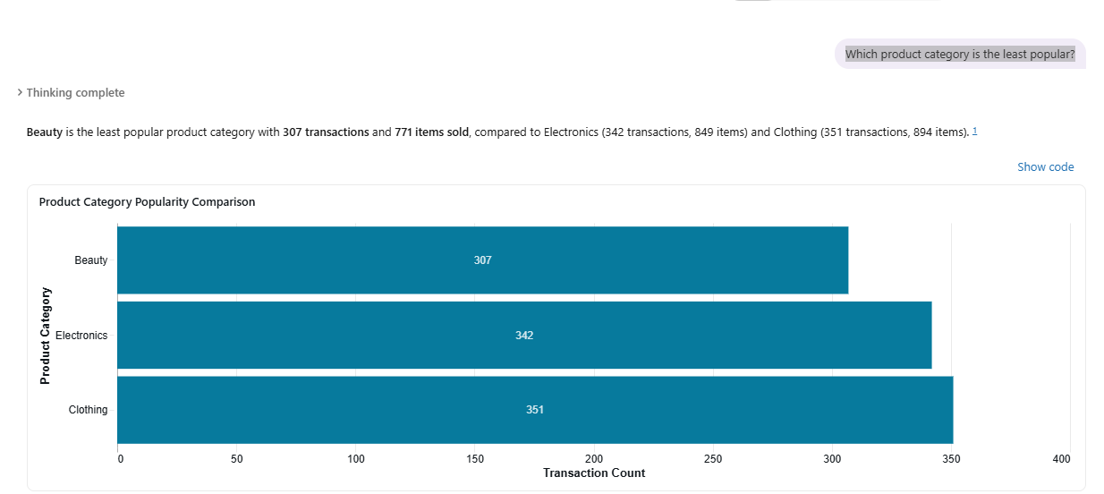
Which product category is the least popular?
The question here was to see which product category is the least popular
Results are the same, no discrepancies

Slide 12
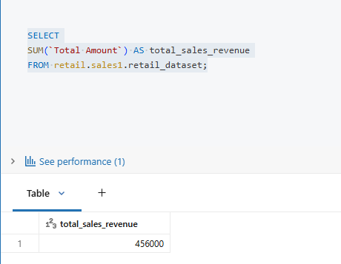
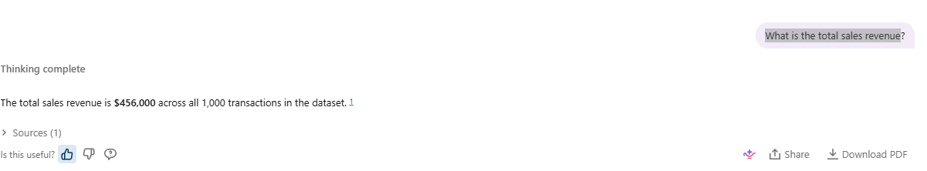
The question here was to see the total sales in revenue

Slide 13
Key Insights from the Retail Sales Analysis
The store generated $456,000 in total sales from 1,000 transactions, with an average transaction value of $456.
Female customers spent slightly more than male customers, contributing 51% of total sales.
Electronics was the highest-performing product category, while Beauty was the least popular. Although Clothing sold the most items, Electronics generated more revenue due to its higher-priced products.
Customers aged 45–54 spent the most overall, while the 18–24 age group had the highest average spend per purchase.
Sales peaked in May and were lowest in September, with strong sales returning towards the end of the year.
The analysis also identified the top 10 customers, each spending $2,000, making them the highest-value customers in the dataset.

Slide 14
Business recommendations
Focus Clothing and Beauty promotions on female customers, and promote Electronics to male customers.
Target 18 to 24 year olds with marketing campaigns, as they tend to make higher-value purchases.
Run special promotions in September to increase sales during the slowest month.
Prepare more stock and marketing campaigns for May, October, and December, as these are the strongest sales months.
Promote Beauty products as premium products since they have a higher average transaction value despite lower sales.

Slide 15
CONCLUSION
This project showed how a Retail Sales Data Agent can make data analysis easier by answering questions in natural language.
One challenge was creating the SQL queries and adjusting the agent's instructions to ensure it gave accurate answers.
If I were to improve this project, I would add product names and brands, customer location, loyalty information, profit data, and sales data from multiple years.
This would help the agent provide more detailed insights and identify long-term sales trends.
Overall, the project showed how data agents can help businesses analyse data faster and make better decisions.

